Slide 1
YouTube’s trending videos
Youtube
With CodingInvaders supervision

Slide 2

An analysis of how average trending periods of videos vary across countries

Slide 3
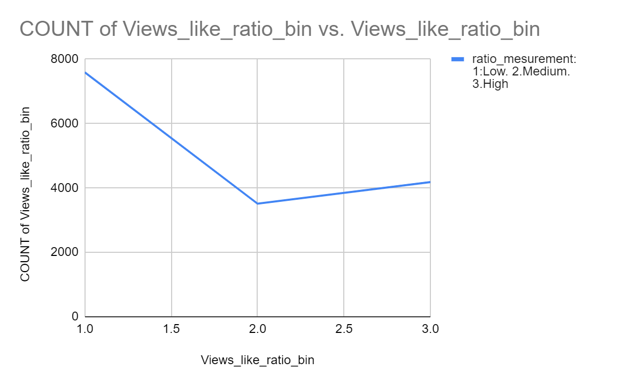
The problem
We need to understand the distribution of duration of trending videos. The videos can trend on multiple days. The popular videos such as new songs, trailer trend longer compared to one of the viral videos. Hence it is important to understand the distribution of duration of videos trending by their respective category. We will need to run a few sql queries to analyze the distribution.

Slide 4

The solution
*Views are most affected by which of the metrics?
Likes
dislikes
comment count
*What is the optimum trending duration?
Trending videos for long duration may see saturation in video views or even decline
Analyze and come up with optimum trending duration for each category
*Detailed channel level analysis, based on frequency of upload and how it impacts trending duration. (One impact could be, channels uploading videos frequently might result in lower trending periods. This is called cannibalization)

Slide 5

The team
I am here to Learn as everyone
Koffi Offori
MCA student and data analyst Learner at codinginvader

Slide 6
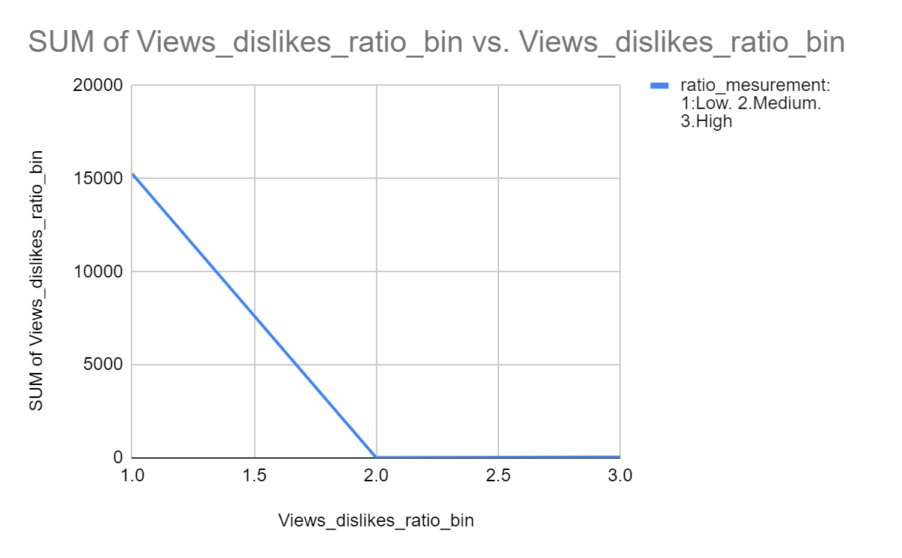
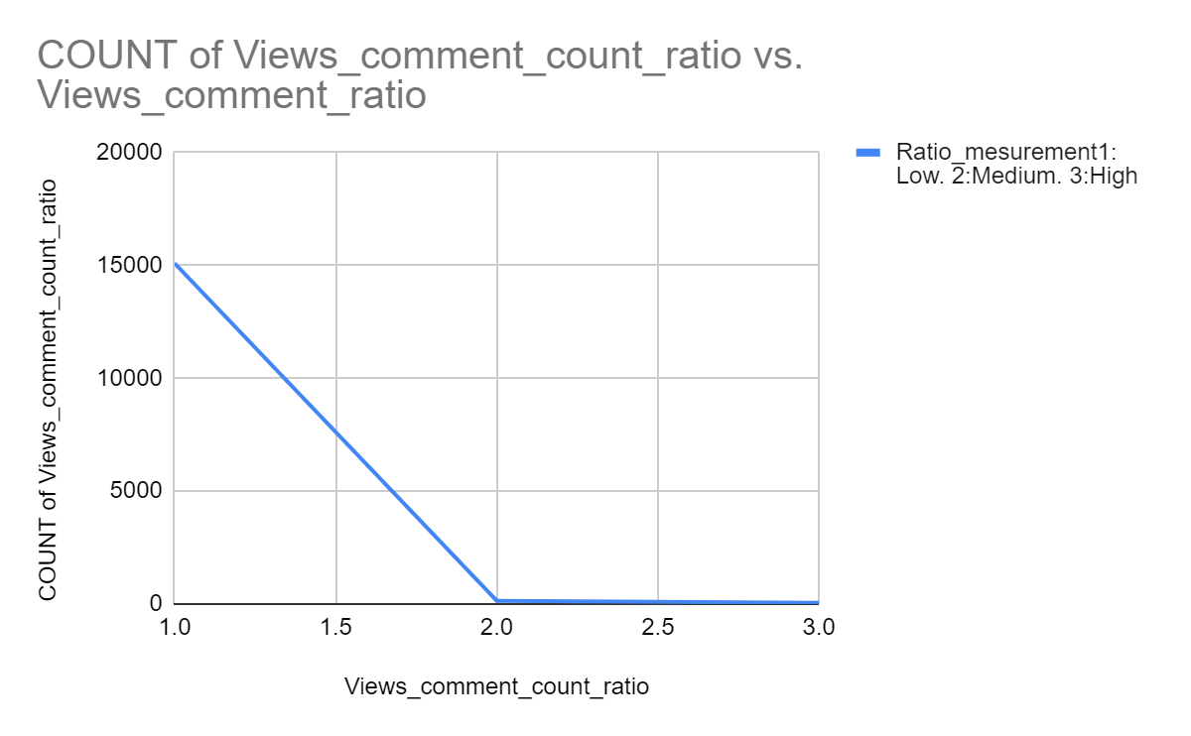
Views are more affected by likes.

Slide 7
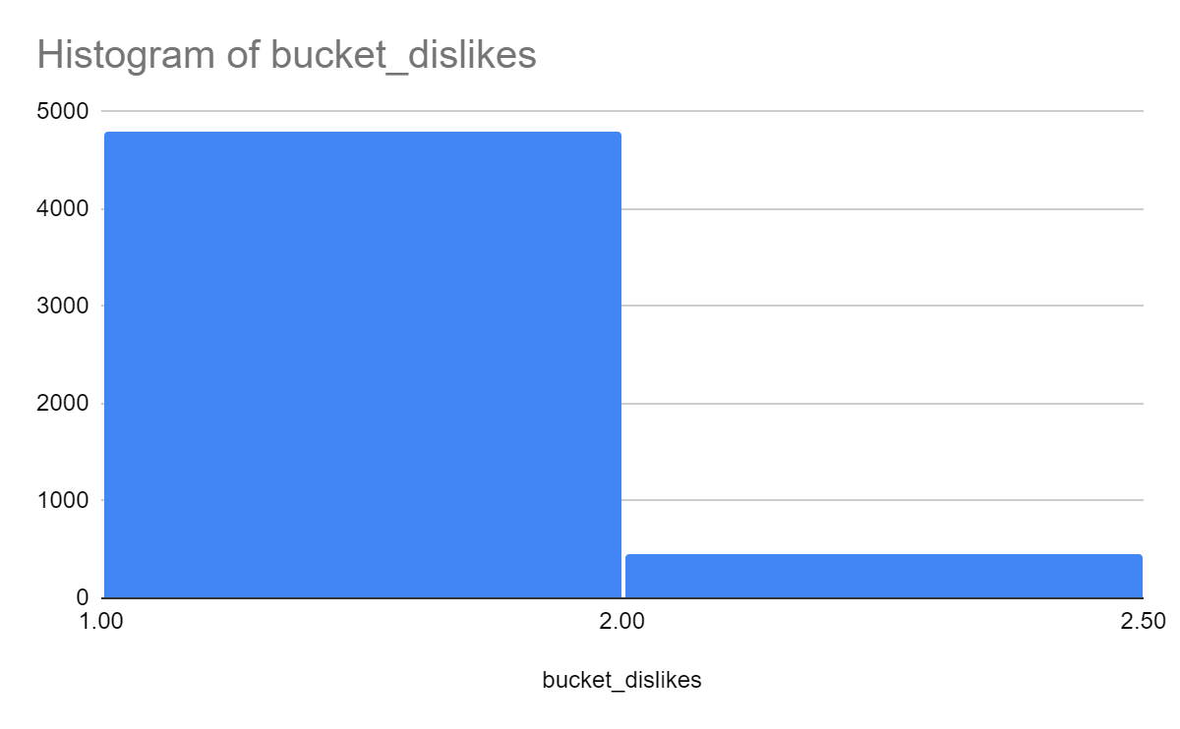
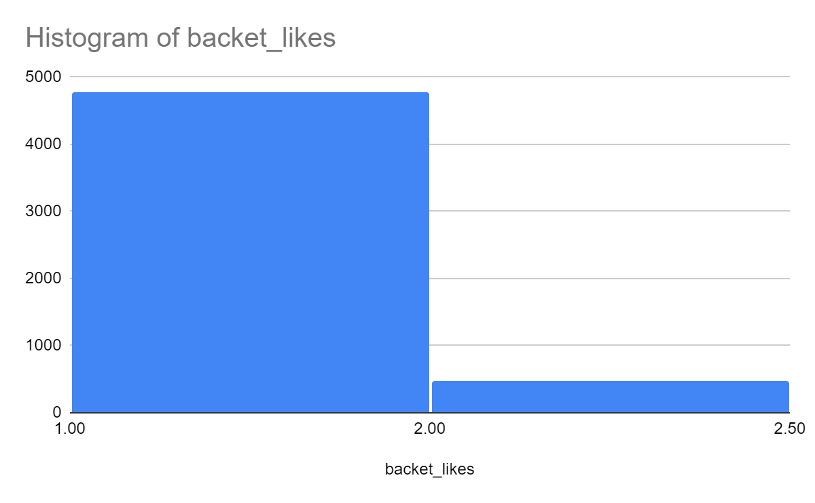
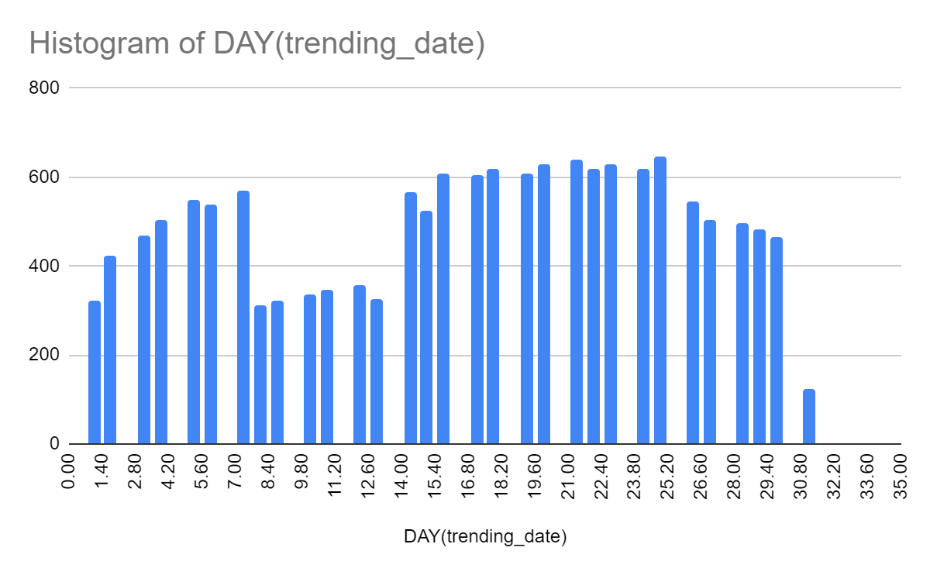
Trending videos tend
to decline

Slide 8


